Slide 1
LESSON 24.02 · WEEK 24
How Can We Practice
Conservation?
NGSS 3-ESS3-1 · Earth and Human Activity

Slide 2
OUR BIG QUESTION
Think About This...
"What can people do to take care of the natural world — and why does it matter which actions we choose?"
Keep this question in mind as you work. By the end, you should be able to answer it with examples from what you did today.

Slide 3
OBJECTIVES
I Can Statements
I can name and explain real conservation practices people use to protect the environment.
I can sort conservation actions by category and explain how each one reduces human impact.
I can evaluate a conservation solution and make a claim about why it helps the environment.
Notes:
Readiness map: I Can #1 (name/explain real conservation practices) is rehearsed in Sections 1-3 (Slides 10-12) and the Conservation in Action photo (Slide 9). I Can #2 (sort actions by category, explain reduced impact) is rehearsed in the 12-action sort activity (Slides 18-21) and the copy chart (Slide 22). I Can #3 (evaluate a solution, make a claim) is rehearsed via the Comparing Solutions criteria/constraints table (Slide 13), Think Like a Conservationist (Slide 23), Record Your Thinking (Slide 24), and the formal Write & Explain (Slide 30). All three assessed in Self-Check (Slides 26-28) and Assignment (Slides 29-31).

Slide 4
YOU'LL NEED
Materials
Science notebook
Pencil & colored pencils
Scissors (optional)
Action Sort cards (printed or written)

Slide 5
NOTICE & WONDER
What Do You Already Know?
Think about the last time you saw someone — or something — taking care of the natural world. Maybe a recycling bin. Maybe a nature preserve. Maybe someone turning off a faucet.
WHAT DO YOU NOTICE? WHAT DO YOU WONDER?
Write 3 things people do to take care of the environment. Then write 1 question you have: something you're not sure about or want to know more about.

Slide 6
WORD WALL
Key Vocabulary — Part 1
Conservation
Protecting natural resources — like water, land, and wildlife — so they aren't used up or destroyed.
Recycling
Collecting used materials — like paper, plastic, or metal — and turning them into something new.
Habitat
The natural home where a plant or animal finds food, water, and shelter.

Slide 7
WORD WALL
Key Vocabulary — Part 2
Water Conservation
Using water carefully and reducing waste, so there is enough clean water for people, animals, and plants.
Reduce
Using less of something — like electricity, plastic, or water — so fewer resources are used up or wasted.
Stewardship
Taking responsibility for caring for the Earth. A steward looks after something that belongs to everyone.

Slide 8
COPY THIS DOWN
In Your Science Notebook
"Conservation means protecting natural resources so they last for future generations."

Slide 9
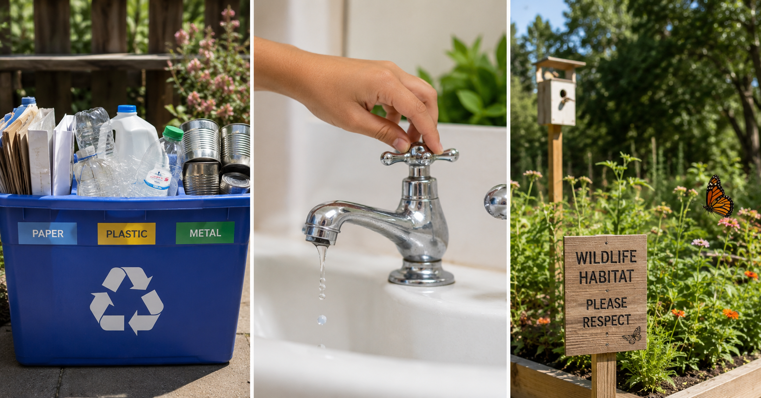
PHOTO · CONSERVATION IN ACTION
Choices That Help the Natural World
Conservation in action: recycling, water care, and habitat protection working together.
People make choices every day that either help or harm the natural world. These are three ways that real communities protect it.

Slide 10
THE LESSON · SECTION 1
Reducing Waste
Every day, people throw things away — food packaging, old paper, plastic bottles. But a lot of that waste doesn't have to be waste. Recycling turns old materials into new ones. Even smarter is to reduce in the first place — buying less, choosing products with less packaging, and reusing things before throwing them out. Less trash going in means less damage coming out.
SCIENTIST TALK
If your whole school stopped using single-use plastic bags for one year, what do you think would happen to the amount of trash in your community?

Slide 11
THE LESSON · SECTION 2
Water Conservation
Fresh water is not unlimited — only a small fraction of Earth's water is fresh water we can drink or use to grow food. Water conservation means making thoughtful choices: turning off the tap while brushing your teeth, fixing leaky pipes, or planting drought-resistant plants. These small choices add up fast — a single dripping faucet wastes over 3,000 gallons of water per year.

Slide 12
THE LESSON · SECTION 3
Protecting Habitats
When land is cleared for buildings or roads, animals lose their homes. Communities protect habitats by setting aside land as nature preserves, planting native plants, and keeping streams and wetlands clean. National parks protect millions of acres of habitat.
Real-World Connection
The Everglades in Florida is one of the most protected wetland habitats on Earth, home to more than 350 species of birds alone.

Slide 13
COMPARING SOLUTIONS
Which One Works Best?
Engineers and scientists compare solutions by checking them against criteria (what the solution needs to do) and constraints (limits like time, money, or materials).
Criteria | School Recycling Program | Community Tree Planting
Reduces waste going to landfill | Yes — paper and plastic get reused | No — doesn't address waste directly
Helps local animals | Some — less litter, fewer hazards | Yes — trees provide food and shelter
Improves air quality | A little — fewer things burned | Yes — trees clean the air
Constraint: cost | Low — bins and signs | Medium — saplings, tools, volunteers
Constraint: time to see results | Fast — works right away | Slow — trees take years to grow
Neither solution is "wrong." The best choice depends on the problem and constraints you're working with.

Slide 14
TAP A ZONE TO LEARN MORE
Four Categories of Conservation Practice
The interactive shows four categories of conservation practice — each one reduces human impact on the natural world in a different way: reducing waste, conserving water, protecting habitats, and community stewardship.

Slide 15
KEY CONCEPT
Cause and Effect
KEY CONCEPT
Humans can take steps to reduce their impact on the environment. Recycling, conserving water, and protecting habitats are real solutions that make a measurable difference — but only if people actually put them into practice.
Cause and effect: when people reduce waste, landfills shrink. When water is conserved, streams stay fuller. When habitats are protected, wildlife populations recover.

Slide 16
AMAZING CONSERVATION FACT
One Ton of Paper
Recycling one ton of paper saves 17 trees, 7,000 gallons of water, and enough energy to power a home for six months. That's from one trip to the recycling bin.

Slide 17
CURIOUS? GO DEEPER
The 3 R's — And Why Order Matters
You've heard "Reduce, Reuse, Recycle" — the order is intentional. Reducing is more powerful than recycling because using less means fewer resources are needed in the first place. Reusing keeps a product in use without creating new waste. Recycling still uses energy and water. In a circular economy, waste from one process becomes raw material for another — almost nothing gets thrown "away." This is how nature already works: leaves fall, decompose, and become soil.

Slide 18
INVESTIGATION
Conservation Action List (1–6)
Sort, rate, and plan. Below is a list of 12 real conservation actions.
1. Turn off lights when leaving a room
2. Recycle paper and plastic at home
3. Take shorter showers
4. Plant native flowers in a yard
5. Bring a reusable bag to the store
6. Fix a leaky faucet

Slide 19
INVESTIGATION
Conservation Action List (7–12)
7. Leave a wild area of a yard unmowed
8. Compost food scraps instead of trashing them
9. Only run the dishwasher when it's full
10. Volunteer to clean up a stream or trail
11. Choose products with less packaging
12. Install a rain barrel to collect water

Slide 20
REHEARSAL · SORT, RATE, PICK, PLAN
Four Steps to Work Through
Sort the Actions: Draw three columns — Reduce Waste, Save Water, Protect Habitat. Write each action under the column that fits best.
Rate the Impact: Rate each action 1-3 stars (1 = one person, 2 = a neighborhood, 3 = an ecosystem or whole community).
Pick Your Best Action: Choose the action that would make the biggest difference in your community. Explain your choice.
Make a Mini Plan: In 3-5 sentences, write what you'd do, who would help, and what would change. Use two vocabulary words.

Slide 21
COPY THIS CHART
Conservation Action Sort
COPY: Conservation Action | Category | ⭐ Impact Rating (1–3) — one row for each of the 12 actions
SCIENTIST TALK
Two actions might both protect water — but one might protect more water, or protect it in a more lasting way. How do you decide which one matters more? What would you need to know?

Slide 22
REHEARSAL · RECORD YOUR THINKING
Organize and Explain Your Reasoning
Did any of the 12 actions surprise you — harder to categorize, or bigger/smaller impact than expected? Explain.
Which category had the most actions? Why do you think that is?
Draw a simple diagram showing one conservation action and its effect. Label at least 3 parts: the action, the resource it protects, and one animal or plant that benefits.
Tell the story of your investigation from start to finish — what you sorted, what you found, and what you decided to plan.

Slide 23
DISCUSSION · THINK IT THROUGH
Think Through Each Question On Your Own
Which action in your top category is easiest for most families to do right now — and which would be hardest? Why?
You gave one action a 3-star rating. What evidence do you have that it really makes a big difference?
If a community stopped all habitat protection efforts for 10 years, what would happen to the animals and plants that live there?
If you could add a 13th action to the list, what would it be and why?

Slide 24
QUICK SELF-CHECK · QUESTION 1
What Does Conservation Mean?
What does the word conservation mean?
A) Throwing old materials into a landfill
B) Protecting natural resources so they aren't used up or destroyed
C) Burning waste to reduce how much goes to the dump
WHAT DO YOU NOTICE? WHAT DO YOU WONDER?
What do you notice in this scenario that helps you decide? What do you wonder about before you answer?
CHAT
Think back to the vocab cards. Conservation is about protecting resources, not getting rid of them.
Notes:
Tests the core definition of conservation.

Slide 25
QUICK SELF-CHECK · QUESTION 1
What Does Conservation Mean? — Answer
Correct: B — Conservation means taking care of resources — land, water, wildlife — so they last for future generations.
Notes:
Reinforce that conservation is proactive protection.

Slide 26
QUICK SELF-CHECK · QUESTION 2
Fixing a Leaky Fountain
A community fixes a leaky pipe in a park fountain. What type of conservation practice is this?
A) Habitat protection
B) Reduce waste
C) Water conservation
WHAT DO YOU NOTICE? WHAT DO YOU WONDER?
What do you notice in this scenario that helps you decide? What do you wonder about before you answer?
CHAT
A leaky pipe is about water being wasted. Which conservation category is about using water carefully?
Notes:
Tests classification of a real-world example into the correct conservation category.

Slide 27
QUICK SELF-CHECK · QUESTION 2
Fixing a Leaky Fountain — Answer
Correct: C — Fixing a leak stops water from being wasted; that's water conservation in action. Small fixes add up to a lot of water saved over time.
Notes:
Reinforce that water conservation targets waste in water use specifically.

Slide 28
QUICK SELF-CHECK · QUESTION 3
Native Wildflowers & Unmowed Yard
A family plants native wildflowers along the edge of their yard and leaves a section unmowed. Which conservation practice does this best represent?
A) Habitat protection
B) Recycling
C) Water conservation
WHAT DO YOU NOTICE? WHAT DO YOU WONDER?
What do you notice in this scenario that helps you decide? What do you wonder about before you answer?
CHAT
This is about giving animals a place to live. Which conservation category protects the homes of wildlife?
Notes:
Tests classification of a habitat protection example.

Slide 29
QUICK SELF-CHECK · QUESTION 3
Native Wildflowers & Unmowed Yard — Answer
Correct: A — Native plants and unmowed areas give insects, birds, and small animals food and shelter — that's habitat protection at the neighborhood level.
Notes:
Reinforce that habitat protection can happen at small, neighborhood scale, not just in parks.

Slide 30
ASSIGNMENT · PART A
Classify and Identify
Use your completed sort chart to answer in your notebook: 1) Name one Reduce Waste action and explain how it reduces human impact. 2) Name one Save Water action and explain who or what benefits. 3) Name one Protect Habitat action and name a specific animal or plant that benefits and how.

Slide 31
ASSIGNMENT · PART B & WRITE AND EXPLAIN
Short Answer + Make Your Claim
Part B (complete sentences): 1) What's the difference between reducing and recycling? Why is reducing more powerful? 2) Why is habitat protection important for animals? 3) Explain your star rating for your best conservation action — what makes it high-impact?
WRITE & EXPLAIN — Make a claim: does your chosen conservation action really reduce human impact on the environment? Use what you observed today to support your thinking.
Start with: "I think that [your chosen action] helps the environment because…"
Then: "I know this because during the sort activity, I noticed that…"
Finish with: "This makes sense because when humans [action], the result is that…"

Slide 32
CANVAS SUBMISSION
What to Turn In
SUBMIT ON CANVAS — must include:
Sort chart — all 12 actions placed into a category with an impact rating
Write & Explain response — all three prompts answered with science vocabulary
Notebook diagram, drawn and labeled with at least 3 parts

Slide 33
Great Work, Conservation Scientist!
You've completed Quarter 3 — Human Impact & Conservation!

